Slide 1
A Feature Preserved Mesh Subdivison Framework
17th International Conference on BioInformatics and BioEngineering
\\ Jing Yang, Yongyi Gong, Hefeng Wu \\
Guangdong University of Foreign Studies
\\ Qi Li \\
Western Kentucky University
Intelligence Health and Visual Computing Lab
2017 BIBE

Slide 2
CONTENT
1.
BACKGROUND
2.
3D GEOMETRIC ALGORITHM
3.
BIOMEDICAL UTILITIES
2017 BIBE

Slide 3
Background
Current situation of CG
2017 BIBE

Slide 4
CG - Biomedical Assistants
Recent years, 3D computer graphics technology works as biomedical assistants, including utilization of 3D CT reconstructions, presentations of skeletons and tissues, comparison of genome, etc., due to its visual obviousness.
The technique is widely used for presenting facial bones and their connections, confirmation of borderline or size of diseased tissues and their relation to the adjacent tissues.
2017 BIBE

Slide 5
Pros and Cons
The pros of using Computer Graphics including 3D spatial and triangular meshes to expose nicety of bioinformation has created an ever-titanic amount of spatial data, which requires efficient and accurate process and analysis consequently.
Restrained by the calculation performance of physical devices, medical detailed expression and accuracy of biomedical data is circumstanced.
The contradiction of biomedical precision and data optimization will generate as model precision shrinking.
Hence, one of the solutions is using Mesh Subdivision.
2017 BIBE

Slide 6

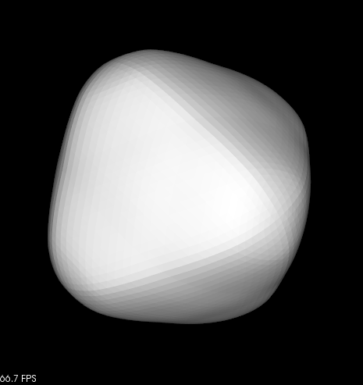

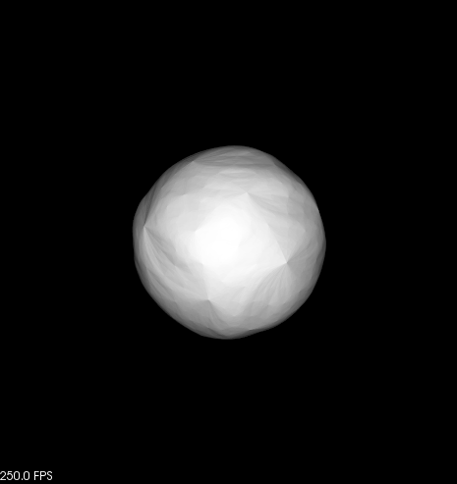
Subdivision Problem
Left 1) Original. Left 2) Butterfly Subdivision. Left 3) Loop Method. Left 4) Catmull Method
Current smoothing methods for each subdivision algorithm will moderate edge and vertex geometric features.
2017 BIBE

Slide 7
3D Geometric Algorithm
A feature preserved mesh subdivision framework
2017 BIBE

Slide 8
FRAMEWORK
1.
Edge Feature Preserved Mesh Subdivision
2.
Wavelike Noise Elimination
3.
Imbalanced Keypoint Detection
2017 BIBE

Slide 9
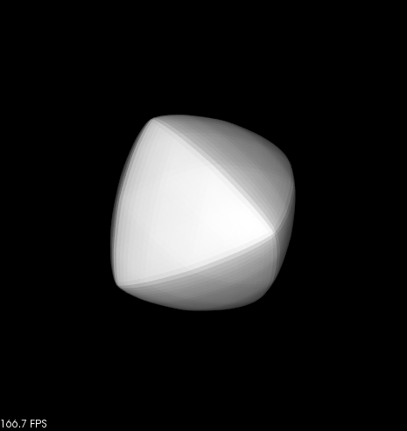
Edge Feature Preserved Mesh Subdivision
As the time of subivision methods iterated increasing, the performance of different algorithm is becoming easier to differentiate.
Obviously, our method accomplished an edge feature remaining and smooth result.
2017 BIBE

Slide 10
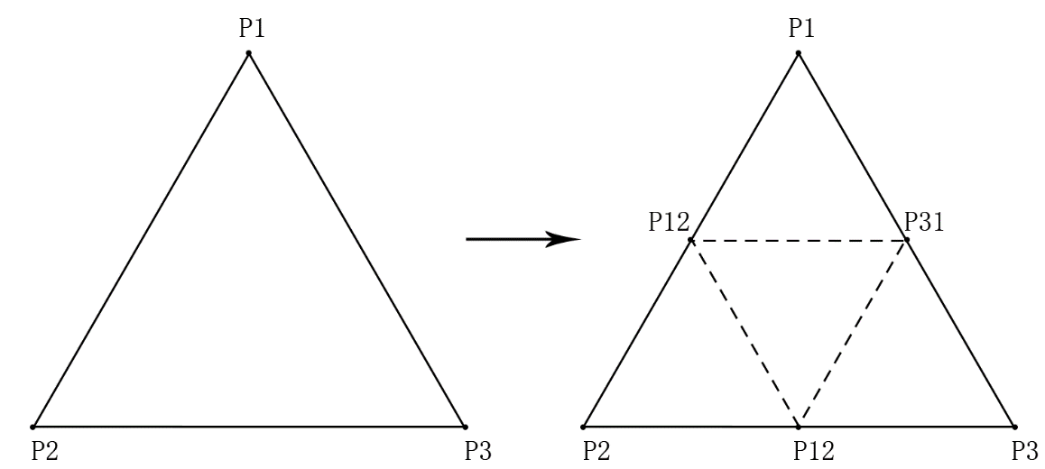
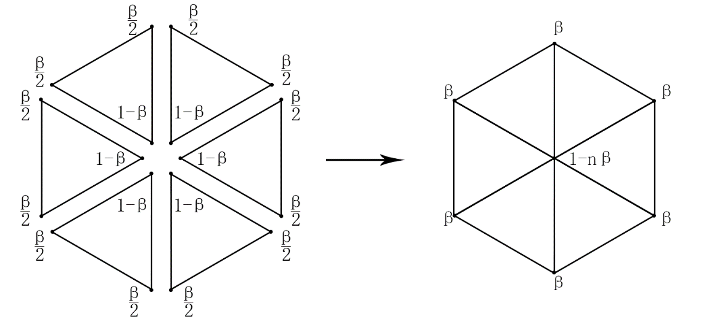
Edge Feature Preserved Subdivision
Input and Output
One to Four Subdivision
Smoothness
Input: Original Mesh $M_{i}$
Input: Original Mesh 𝑀_𝑖
Output: Subdivided Mesh $M_{i+1}$
Output: Subdivided Mesh 𝑀_(𝑖+1)
for each triangular face $f_{i}$ in $M_{i}$ do
for each triangular face 𝑓_𝑖 in 𝑀_𝑖 do
get 3 edge point on edges of $f_{i}$
get 3 edge point on edges of 𝑓_𝑖
generate 4 subfaces anticlockwise
end for
for each vertex $v_{i}$ on $M_{i+1}$do
for each vertex 𝑣_𝑖 on 𝑀_(𝑖+1)do
$N\left(v_{i}\right)=$1-ring neighbors on $M_{i+1}$
𝑁(𝑣_𝑖 )=1-ring neighbors on 𝑀_(𝑖+1)
$v_{i}=$ neighbor weighted centroid method on $v_{i}$
𝑣_𝑖= neighbor weighted centroid method on 𝑣_𝑖
end for
2017 BIBE

Slide 11
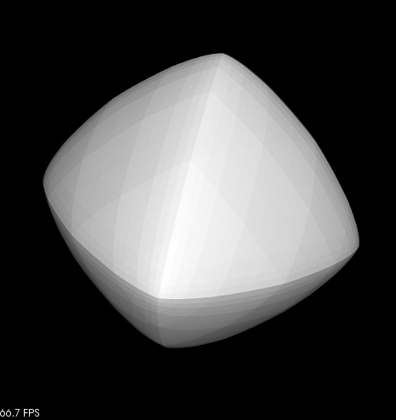
Model-dependent Wavelike Noise
By using the method, an edge and vertex aware result is generated. But the method will generate model-depent wavelike noise on the mesh.
2017 BIBE

Slide 12


Wavelike Noise Elimination
A combination of Edge Feature Preserved Mesh Subdivision and Smooth-based Mesh Subdivision. The noise problem is eliminated.
Smooth-based Mesh Subdivision has the same algorithm structure. Difference is about the smoothing part.
Neighbor vertices for smoothing method depends on previous one-ring vertices on $M_{i}$, but not newly generated vertices on $M_{i+1}$.
2017 BIBE

Slide 13
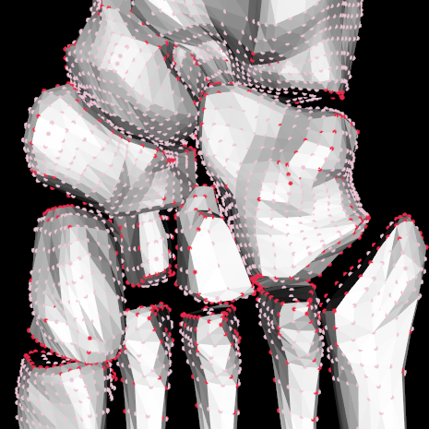
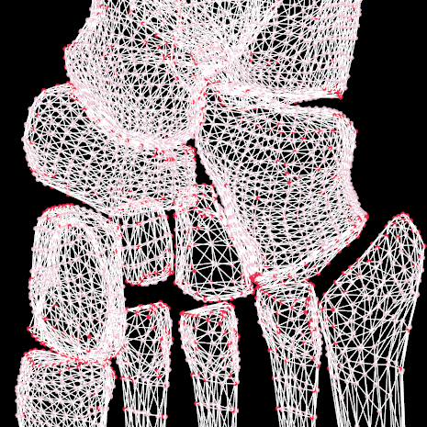
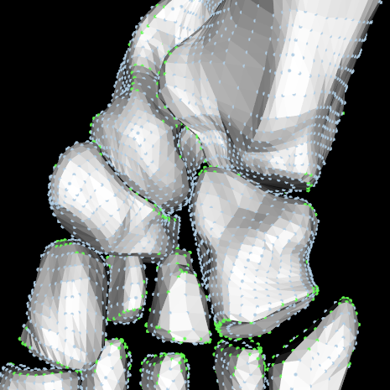
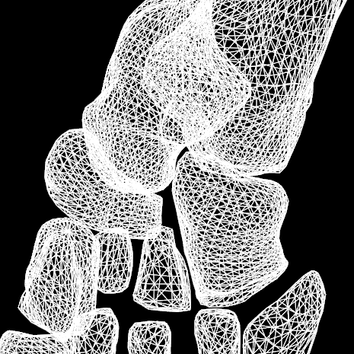
Imbalanced Keypoint Detection
We propose a geometric feature-based vertex operator, which is a three-dimensional implementation of key-points detection, to pick up imbalanced keypoints.
2017 BIBE

Slide 14
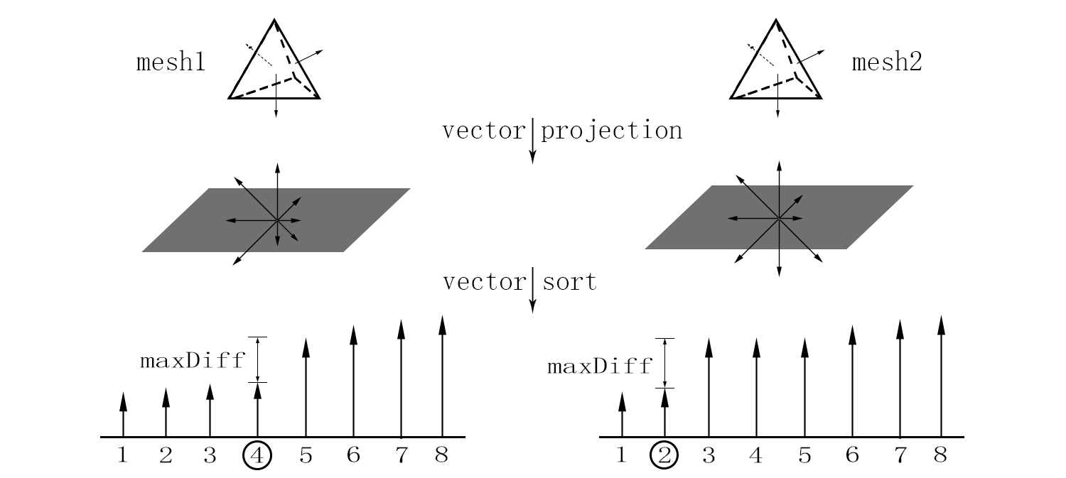
Basic Idea of Keypoint Detection
Basic idea is using normal vectors around the vertex as an identification, using sort and threshold to define if the vertex is a keypoint or not.
After projecting face normals around any vertex on its tangent plane, arrows (suppose 8) are sorted in terms of their magnitudes.
According to the index, a vertex can be classified into balanced point or not.
2017 BIBE

Slide 15
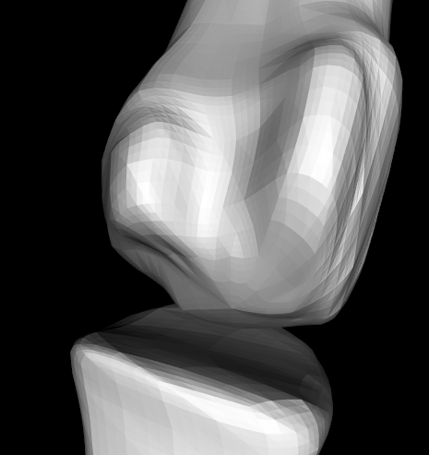
Feature Preserved Mesh Subdivision Framework
The big picture of our framework is using detected points to guide subdivision procedures.
Based on imbalanced keypoint detection, all the vertices are classified into two categories and keypoints are distributed mainly at the boundaries and detailed parts, which should be remained after subdivision but slightly adjusted with its neighbors.
2017 BIBE

Slide 16
Biomedical Utilities
For biomedical meshes
2017 BIBE

Slide 17
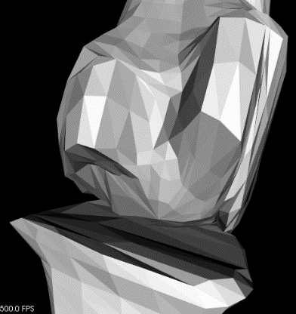
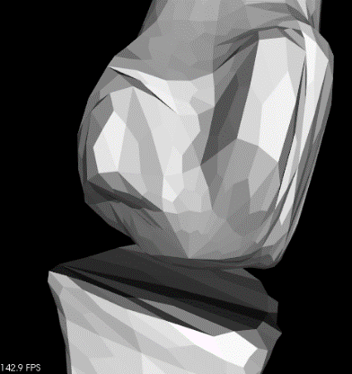
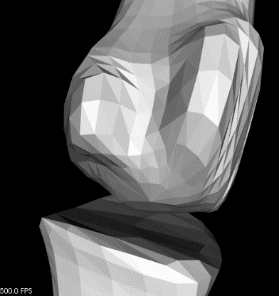
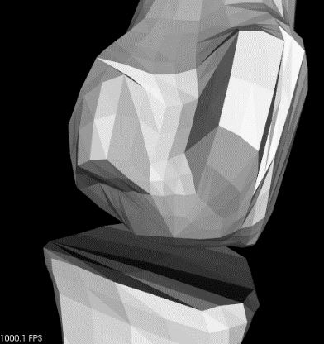

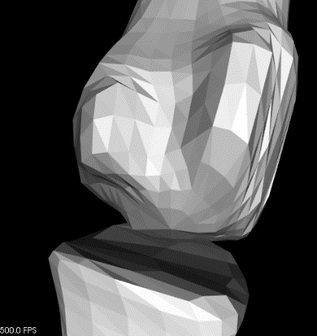
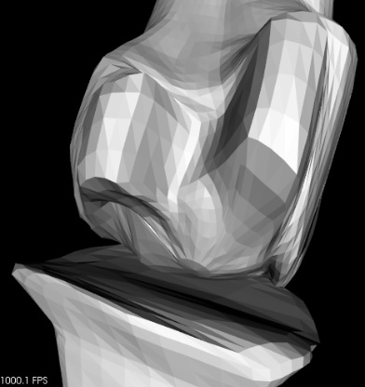
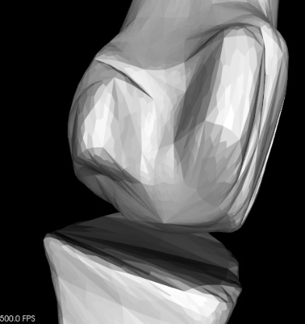
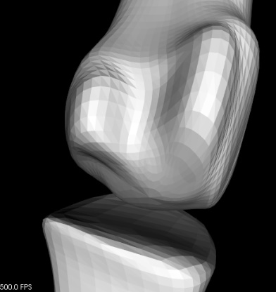
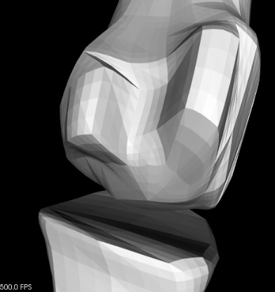
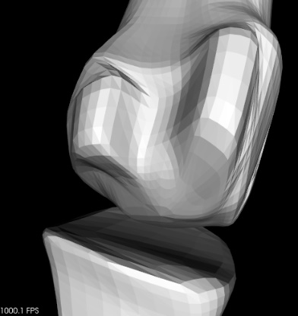




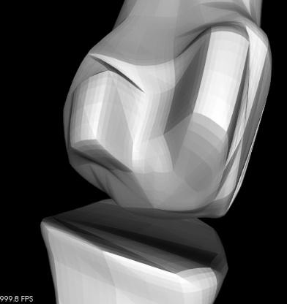


Subdivision Comparison on Phalangeal
Iteration 3
Iteration 4
Iteration 5
2017 BIBE

Slide 18






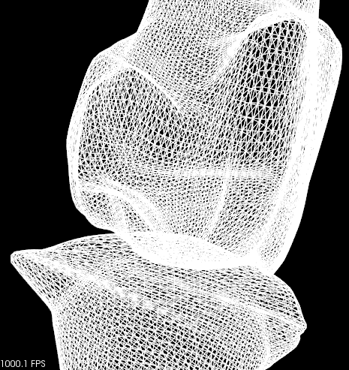
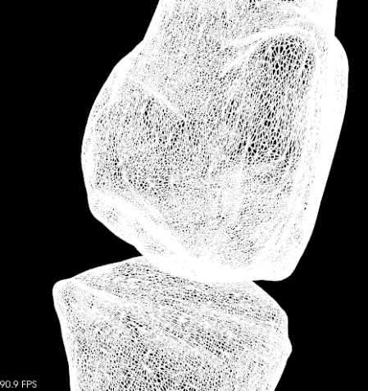
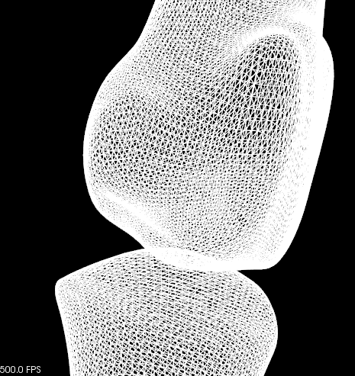
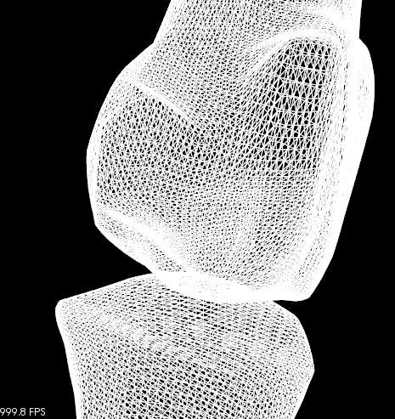

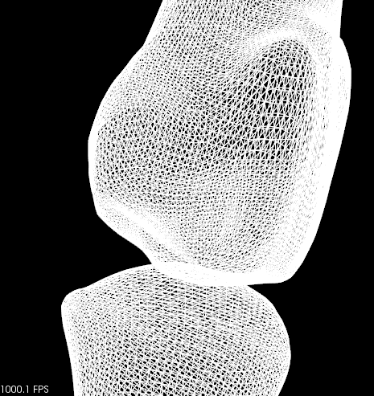
Subdivision Comparison on Phalangeal
Butterfly
Catmull
Loop
EFPMS
SMS
FPMS
2017 BIBE

Slide 19
Subdivision Comparison on Phalangeal
Butterfly
Catmull
Loop
EFPMS
SMS
FPMS
2017 BIBE

Slide 20
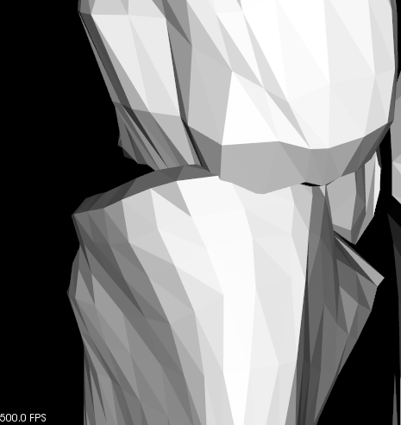
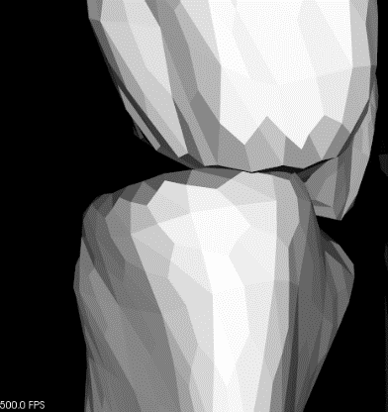
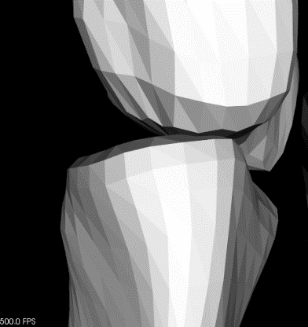
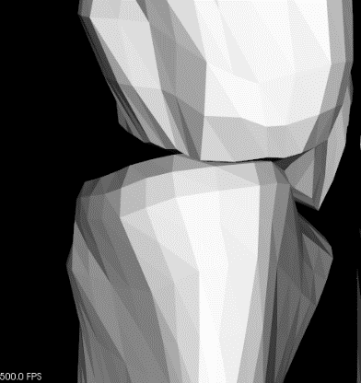


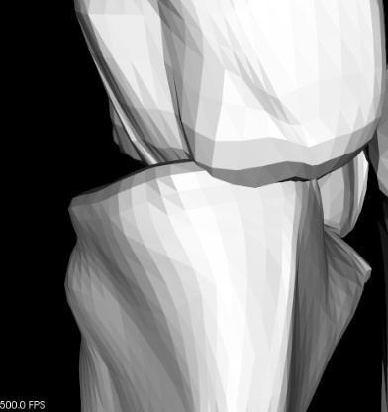

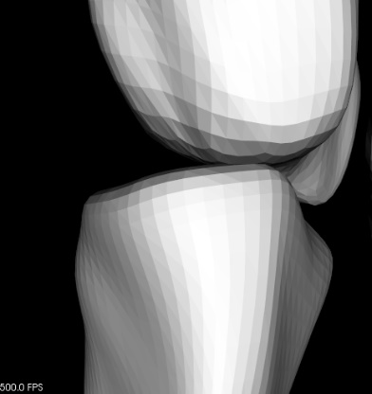


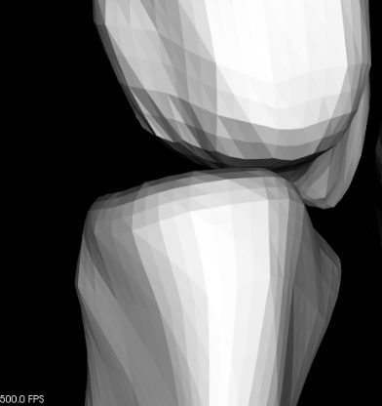
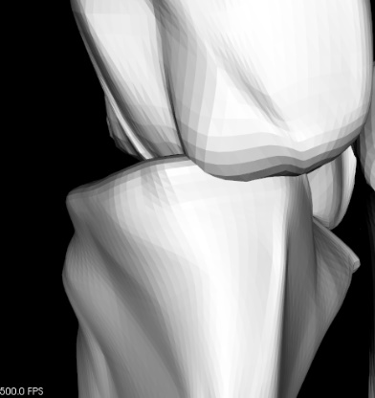





Subdivision Comparison on Metatarsal
Iteration 3
Iteration 4
Iteration 5
2017 BIBE

Slide 21
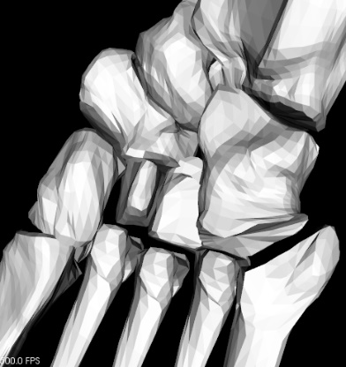
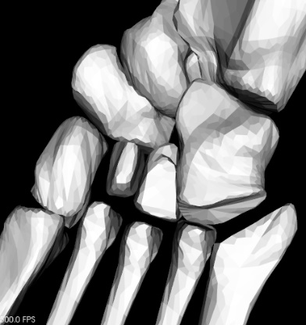






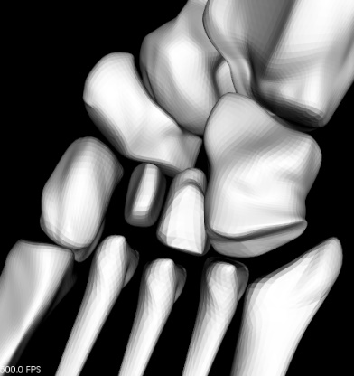


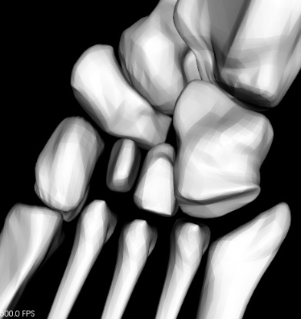






Subdivision Comparison on Footbone
Iteration 3
Iteration 4
Iteration 5
2017 BIBE

Slide 22
Experimental Environment
Based on QT, VS, OpenMesh, and PCL
2017 BIBE

Slide 23
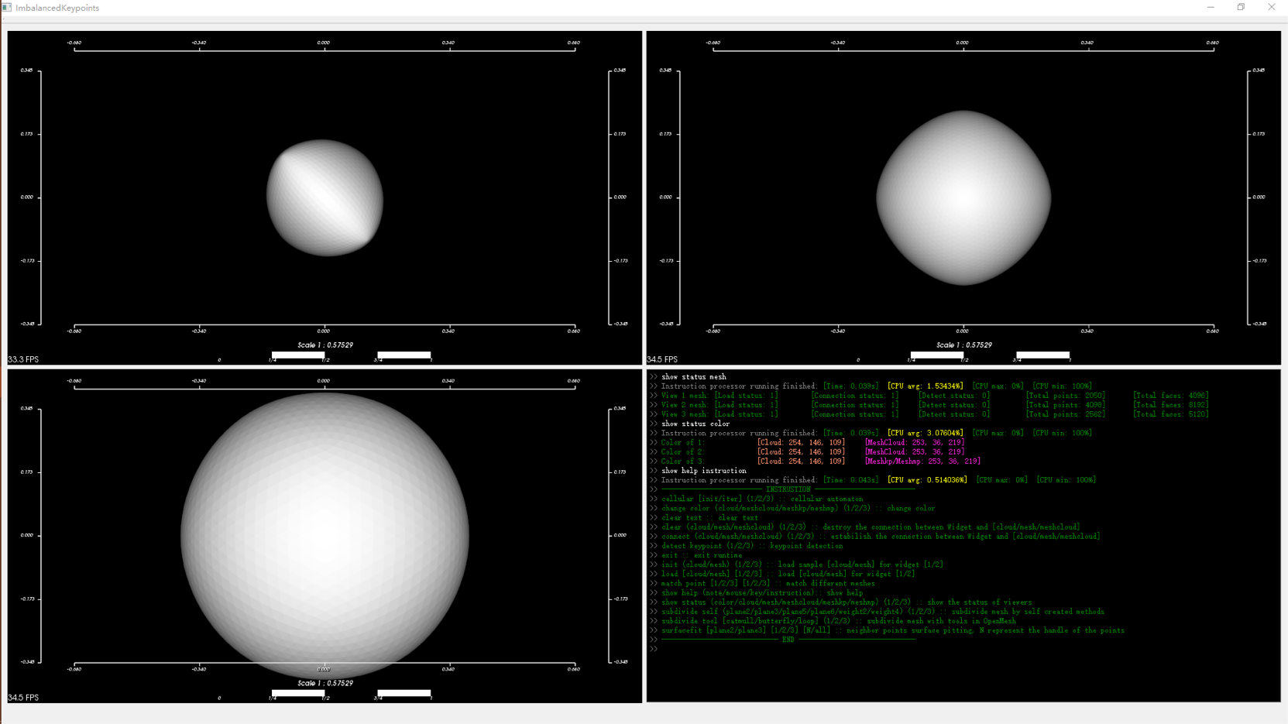
Self-Created Experimental Platform
2017 BIBE

Slide 24
Thank you!
Jing Yang (Carl)
jingyang.carl.china@gmail.com
2017 BIBE

